Slide 1
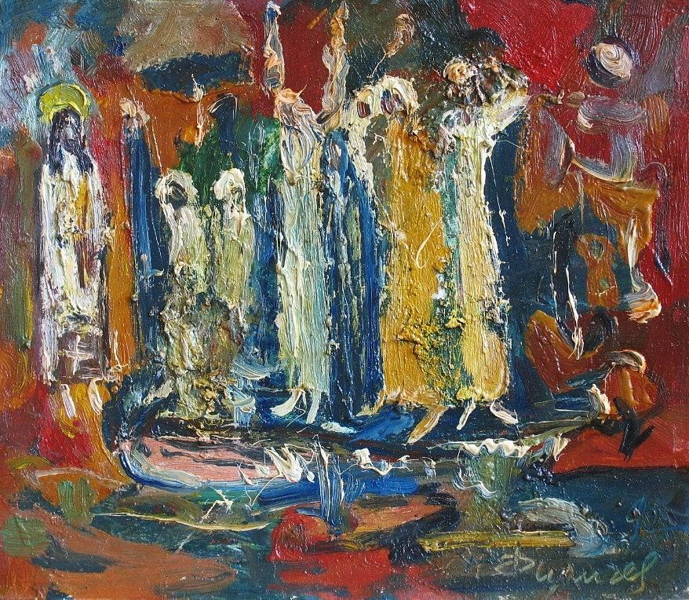
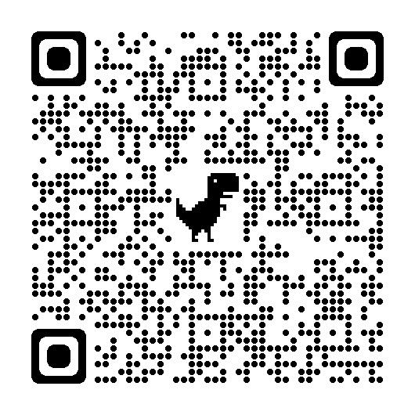
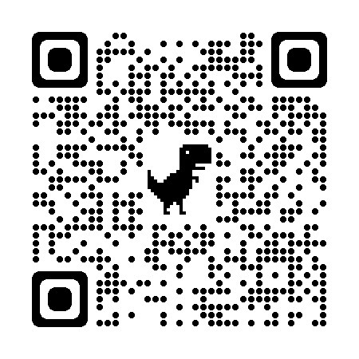
DOXOLOGY*
Praise God from whom all blessings flow;
Praise God, all creatures here below;
Praise God above, ye heavenly host;
Praise Father, Son, and Holy Ghost. Amen.
HOLY COMMUNION
SENDING
SONG* - For Everyone Born
1. For everyone born, a place at the table, 2. For all who share life, a place at the table,
for everyone born, clean water and bread, revising the roles, deciding the share, a shelter, a space, a safe place for growing, with wisdom and grace, dividing the power,
for everyone born, a star overhead. for all who share life, a system that’s fair.
Chorus: 3. For all who have breath, a place at the table,
And God will delight a covenant shared, a welcoming space,
when we are creators of justice a rainbow of race and gender and color, and joy, compassion and peace: for all who have breath, the chalice of grace. Yes, God will delight When we are creators of justice, 4. For everyone born, a place at the table, justice and joy. to live without fear, and simply to be,
to work, to speak out, to witness and worship,
for everyone born, the right to be free.
*Stand, as you are able
As we continue to navigate the implications of Covid we will have two options for partaking. After coming down the center aisle, you can choose one of the two lines. One will have a common cup for intinction (dipping); the other will have individual cups that can be drank from and then placed in the provided empty tray.. Please choose whichever line you feel most comfortable with.
GATHERING
CALL TO WORSHIP*
Come all you are struggling;
come all who are weighed down by suffering and pain;
Come all who can’t see a way forward;
come all who feel lost and abandoned.
Come to worship a God who heals your pain.
Come to worship a God who gives us visions for the future.
Let us worship God, who sets us free and gives us new life.
Use this QR code to sign-up to help Sunday mornings:
Use this QR code to download the app for our new directory and set-up your access:

Slide 2
SONG* - O Love That Will Not Let Me Go
1. O Love that will not let me go, 3. O joy that seekest me through pain, I rest my weary soul in thee. I cannot close my heart to thee. I give thee back the life I owe, I chase the rainbow through the rain that in thine ocean’s depths its flow and feel the promise is not vain may richer, fuller be. that morn shall tearless be.
2. O light that foll’west all my way, 4. O cross that liftest up my head,
I yield my flickering torch to thee. I dare not ask to fly from thee.
My heart restores its borrowed ray I lay in dust, life’s glory dead,
that in thine sunshine’s blaze its day and from the ground there blossoms red
may brighter, fairer be. life that shall endless be.
SONG* - Don’t Be Afraid
PRAYER OF CONFESSION (adapted from PCUSA Book of Common Worship)
ASSURANCE OF PARDON
Friends, believe the good news of the Gospel:
In Jesus Christ we are forgiven.
PASSING OF THE PEACE*
The Lord be with you.
And also with you
SONG* - Ubi Caritas
WORD
OLD TESTAMENT LESSON Psalm 86:1-10
GOSPEL LESSON* Matthew 10:24-39
SERMON Pastor Jolene
RESPONSE
HYMN* - Savior in Thy Love Abiding (#442 in blue hymnal)
PRAYERS OF THE PEOPLE/LORD’S PRAYER
OFFERING
Ubi caritas et amor. Live in charity and steadfast love.
Ubi caritas; Live in charity;
Deus ibi est. God will dwell with you.
Don’t be afraid,
my love is stronger,
my love is stronger than your fear.
Don’t be afraid,
my love is stronger,
and I have promised,
promised to be always near.
For failing to love others as you have loved us:
God of grace, forgive us.
For wasting your gifts and hoarding our goods:
God of grace, forgive us.
For plundering the earth and abusing the planet:
God of grace, forgive us.
For fearing those who are strange to us and ignoring those in need:
God of grace, forgive us.
For hardening our hearts to grief and abandoning hope:
God of grace, forgive us.
For all the ways we turn from you:
God of grace, forgive us.

